Slide 1

SOKOINE UNIVERSITY OF AGRICULTURE
School of Engineering and Technology | Department of Agricultural Engineering
AEN 214: INTRODUCTION TO ELECTRONICS — LECTURE 4
Special Purpose Diodes
Zener Regulators, LEDs & PAR Lighting, Schottky Solar Bypass, and Photodiodes
Course Instructor: Dr. Kadeghe Goodluck Fue, PhD, P.Eng (T)
Electronics & Precision Agriculture Laboratory | Academic Year 2025/2026 | Sokoine University of Agriculture
Sokoine University of Agriculture | School of Engineering & Technology | Department of Agricultural Engineering
Slide 1 of 26

Slide 2
AEN 214: INTRODUCTION TO ELECTRONICS
Lecture 4 Learning Outcomes & Practical Scope
• Master Zener Diode Physics: Differentiate Zener tunneling vs avalanche breakdown, knee current I_ZK, and power limits.
• Design Zener Shunt Voltage Regulators: Size series resistor R_S across variable DC line voltages and fluctuating sensor loads.
• Analyze Light Emitting Diodes (LEDs): Evaluate direct vs indirect bandgap physics, forward drop V_F, and electroluminescence.
• Apply LEDs to Photosynthetic Lighting: Calculate Photosynthetically Active Radiation (PAR) and Photosynthetic Photon Flux (PPF).
• Evaluate Schottky Barrier Diodes: Metal-semiconductor junction physics, ultra-low forward drop (0.3V), and zero reverse recovery.
• Implement Solar Panel Bypass Protection: Prevent hot-spot thermal damage and current choking in shaded photovoltaic strings.
• Understand Optical & Surge Devices: Analyze PIN photodiodes, solar cells, and Transient Voltage Suppressors (TVS).
Sokoine University of Agriculture | School of Engineering & Technology | Department of Agricultural Engineering
Slide 2 of 26

Slide 3
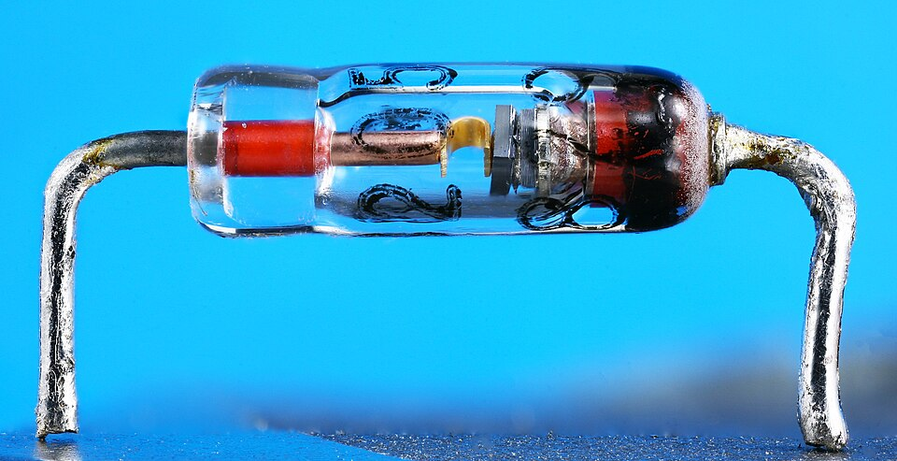
AEN 214: INTRODUCTION TO ELECTRONICS
Special Purpose Diodes in AgriTech Systems
• Unregulated Off-Grid Power: Solar panels and battery banks experience severe voltage swings (10.5V to 14.8V).
• Stable Reference Voltages: Zener diodes provide ultra-stable 3.3V and 5.0V voltage references for microcontroller ADCs.
• Controlled-Environment Agriculture (CEA): High-efficiency LED grow luminaires deliver tailored spectral recipes in Arusha greenhouses.
• Solar Water Pumping Efficiency: High forward voltage drops across ordinary silicon diodes waste valuable solar energy.
• Schottky Diodes in Solar Arrays: Reduce bypass conduction power losses by 60%, delivering more water per kilowatt of solar PV.
Sokoine University of Agriculture | School of Engineering & Technology | Department of Agricultural Engineering
Slide 3 of 26

Slide 4
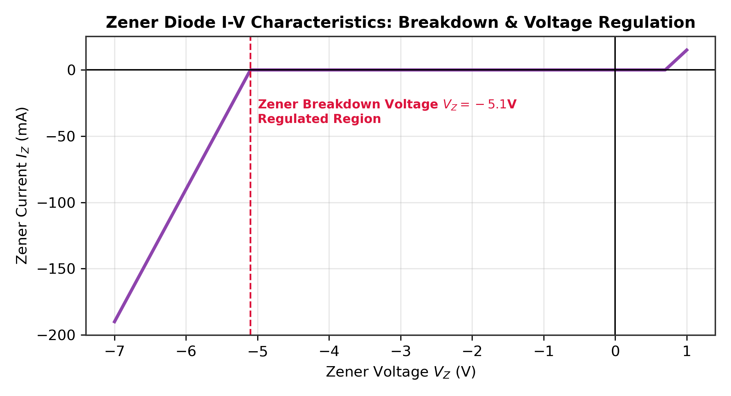
AEN 214: INTRODUCTION TO ELECTRONICS
Zener Diode Fundamentals & Breakdown Physics
• Heavy Doping Profile: Silicon PN junction with high impurity doping (10^18 to 10^19 cm^-3); extremely narrow depletion layer (< 10 nm).
• Reverse Breakdown Characteristic: In reverse bias, voltage remains almost perfectly constant at V_Z despite huge current changes.
• Zener Knee Current (I_ZK): Minimum reverse current required to enter the stable breakdown voltage plateau (typically 0.25 to 1.0 mA).
• Zener Test Current (I_ZT): Specified manufacturer test current where nominal Zener voltage V_Z is guaranteed (typically 5 to 20 mA).
• Maximum Zener Current (I_ZM): Maximum safe reverse current limited by package thermal dissipation: I_ZM = P_Z(max) / V_Z.
Sokoine University of Agriculture | School of Engineering & Technology | Department of Agricultural Engineering
Slide 4 of 26

Slide 5
AEN 214: INTRODUCTION TO ELECTRONICS
Zener Dynamic Impedance & Temperature Coefficient
• Dynamic Zener Impedance: r_z = Delta V_Z / Delta I_Z; The inverse slope of the vertical breakdown I-V characteristic.
• Ideal vs Practical Model: Ideal Zener: r_z = 0 (perfect battery V_Z); Practical Zener: V_Z(actual) = V_Z0 + I_Z · r_z.
• Regulation Quality: Lower dynamic impedance r_z yields stiffer voltage regulation against load current fluctuations.
• Temperature Coefficient (TC): Quantifies Zener voltage drift with temperature: TC = (Delta V_Z / V_Z) / Delta T x 100% (°C^-1).
• Zero-Tempco Point: Diodes with V_Z ≈ 5.6 V achieve nearly zero temperature drift because negative Zener and positive Avalanche TC cancel!
Sokoine University of Agriculture | School of Engineering & Technology | Department of Agricultural Engineering
Slide 5 of 26

Slide 6
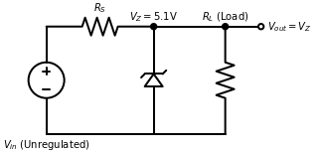
AEN 214: INTRODUCTION TO ELECTRONICS
Zener Shunt Voltage Regulator Architecture
• Circuit Topology: Series ballast resistor R_S placed between unregulated DC supply V_in and parallel combination of Zener and load R_L.
• Kirchhoff's Current Law: Total input current I_S splits into Zener current and load current: I_S = I_Z + I_L.
• Voltage Dropping Action: Series resistor drops the difference voltage: V_RS = V_in - V_Z; Current I_S = (V_in - V_Z) / R_S.
• Line Regulation: When input V_in increases, excess current shunts through Zener diode (Delta I_Z), keeping V_out = V_Z rock steady.
• Load Regulation: When load R_L pulls more current I_L, current is diverted away from Zener diode without changing V_out.
Sokoine University of Agriculture | School of Engineering & Technology | Department of Agricultural Engineering
Slide 6 of 26

Slide 7
AEN 214: INTRODUCTION TO ELECTRONICS
Design Boundaries for Zener Shunt Regulators
• Condition 1 (Minimum Input Voltage & Maximum Load Current): Zener must maintain minimum knee current I_ZK to prevent dropout.
• Maximum Resistor Value: R_S(max) = (V_in(min) - V_Z) / (I_L(max) + I_ZK).
• Condition 2 (Maximum Input Voltage & Minimum Load Current): Zener must not exceed maximum thermal dissipation P_Z(max).
• Minimum Resistor Value: R_S(min) = (V_in(max) - V_Z) / (I_L(min) + I_ZM), where I_ZM = P_Z(max) / V_Z.
• Ballast Resistor Wattage: Resistor power rating must withstand maximum dissipation: P_RS = (V_in(max) - V_Z)² / R_S.
Sokoine University of Agriculture | School of Engineering & Technology | Department of Agricultural Engineering
Slide 7 of 26

Slide 8
AEN 214: INTRODUCTION TO ELECTRONICS
Worked Engineering Example 1: Zener Shunt Regulator for Greenhouse Soil Moisture ADC
PROBLEM SPECIFICATION & AGRICULTURAL CONTEXT:
Design a 5.1V Zener shunt voltage regulator to power a precision soil moisture ADC module in a Morogoro greenhouse. Unregulated DC supply varies between V_in(min) = 11.0 V and V_in(max) = 15.0 V. The ADC load current varies from I_L(min) = 5.0 mA to I_L(max) = 35.0 mA. The 1N4733A Zener diode has V_Z = 5.1 V, P_Z(max) = 1.0 W, and knee current I_ZK = 1.0 mA. Determine: (a) Maximum allowable R_S, (b) Minimum allowable R_S, (c) Standard 5% resistor selection, (d) Resistor power rating.
STEP-BY-STEP MATHEMATICAL SOLUTION & VERIFICATION:
1. Calculate Maximum Allowable Zener Current: I_ZM = P_Z(max) / V_Z = 1.0 W / 5.1 V = 0.1961 A = 196.1 mA.
2. Calculate R_S(max) to Guarantee Regulation at Worst-Case Low Input:
R_S(max) = (V_in(min) - V_Z) / (I_L(max) + I_ZK) = (11.0 V - 5.1 V) / (35.0 mA + 1.0 mA) = 5.9 V / 36.0 mA = 163.9 Ohm.
3. Calculate R_S(min) to Prevent Zener Burnout at Worst-Case High Input:
R_S(min) = (V_in(max) - V_Z) / (I_L(min) + I_ZM) = (15.0 V - 5.1 V) / (5.0 mA + 196.1 mA) = 9.9 V / 201.1 mA = 49.2 Ohm.
4. Standard Resistor Selection: Choose standard value within 49.2 Ohm < R_S < 163.9 Ohm. Select standard R_S = 100 Ohm (5%).
5. Resistor Power Rating: P_RS(max) = (V_in(max) - V_Z)² / R_S = (15.0 - 5.1)² / 100 = (9.9)² / 100 = 0.980 W. (Use 2.0 W wirewound resistor with 50% safety factor).
Sokoine University of Agriculture | School of Engineering & Technology | Department of Agricultural Engineering
Slide 8 of 26

Slide 9
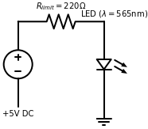
AEN 214: INTRODUCTION TO ELECTRONICS
Light Emitting Diodes: Electroluminescence Physics
• Direct vs Indirect Bandgap: Silicon has indirect bandgap (recombination yields heat/phonons); compound semiconductors have direct bandgap.
• Spontaneous Photon Emission: Forward bias injects electrons and holes; radiative recombination emits photons with energy E = h · f = h · c / lambda.
• Emission Wavelength: lambda = (h · c) / E_g ≈ 1240 / E_g(eV) (nanometers). Bandgap energy E_g dictates emitted color!
• Semiconductor Materials: Gallium Arsenide (GaAs: Infrared, 900 nm), AlGaInP (Red/Amber, 620-660 nm), InGaN (Blue/Green/UV, 450 nm).
• Forward Voltage Drop Disparity: Red LEDs: V_F ≈ 1.8V to 2.1V; Blue/White LEDs: V_F ≈ 3.0V to 3.4V (proportional to bandgap energy!).
Sokoine University of Agriculture | School of Engineering & Technology | Department of Agricultural Engineering
Slide 9 of 26

Slide 10
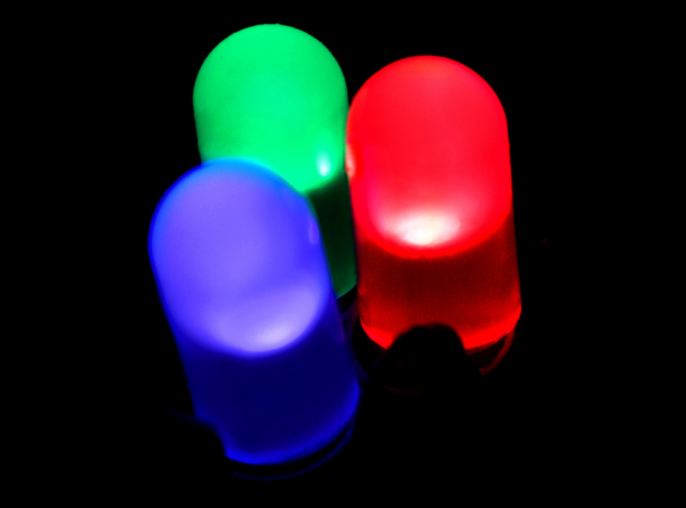
AEN 214: INTRODUCTION TO ELECTRONICS
Photosynthetically Active Radiation (PAR) & Grow Lighting
• Chlorophyll Absorption Peaks: Chlorophyll 'a' absorbs heavily at 430 nm (deep blue) and 662 nm (deep red); Chlorophyll 'b' at 453 nm and 642 nm.
• Photosynthetically Active Radiation (PAR): Spectral waveband from 400 nm to 700 nm driving crop photosynthesis.
• Photosynthetic Photon Flux (PPF): Total micromoles of PAR photons emitted per second (micro-mol/s); efficacy > 2.8 micro-mol/Joule.
• Spectral Tuning Recipes: High blue ratio (450 nm) prevents stem elongation and promotes leafy growth; Deep red (660 nm) accelerates flowering.
• Commercial CEA Advantage: LED luminaires produce 65% less radiant heat than high-pressure sodium (HPS) lamps, cutting greenhouse cooling costs.
Sokoine University of Agriculture | School of Engineering & Technology | Department of Agricultural Engineering
Slide 10 of 26

Slide 11
AEN 214: INTRODUCTION TO ELECTRONICS
Worked Engineering Example 2: PAR LED Grow Light String Sizing for Arusha Roses
PROBLEM SPECIFICATION & AGRICULTURAL CONTEXT:
A commercial floriculture greenhouse in Arusha utilizes high-intensity deep-red LED arrays (lambda = 660 nm) for supplemental flowering stimulation. Each LED has forward voltage V_F = 2.20 V at rated continuous forward current I_F = 350 mA. The string is powered from a regulated 24.0 V DC power bus. Determine: (a) Maximum number of series LEDs in one string, (b) Series ballast resistor R_limit, (c) Resistor power dissipation, (d) Electrical efficiency of the string.
STEP-BY-STEP MATHEMATICAL SOLUTION & VERIFICATION:
1. Determine Maximum Series LED Count: Total LED drop must not exceed supply: N · V_F < V_supply -> N < 24.0 V / 2.20 V = 10.9.
Allowing a 2.0 V headroom for stable current regulation, choose N = 9 series LEDs.
2. Total Series LED Forward Voltage: V_string = 9 · 2.20 V = 19.80 V.
3. Ballast Resistor Calculation: V_R = V_supply - V_string = 24.0 V - 19.80 V = 4.20 V.
R_limit = V_R / I_F = 4.20 V / 0.350 A = 12.0 Ohm.
4. Resistor Power Dissipation: P_R = I_F² · R_limit = (0.350 A)² · 12.0 Ohm = 0.1225 · 12.0 = 1.47 W. (Use 3.0W or 5.0W rating).
5. Electrical Efficiency of String: P_LEDs = 19.80 V · 0.35 A = 6.93 W; P_total = 24.0 V · 0.35 A = 8.40 W.
Efficiency eta = P_LEDs / P_total = 6.93 W / 8.40 W = 82.5%.
Sokoine University of Agriculture | School of Engineering & Technology | Department of Agricultural Engineering
Slide 11 of 26

Slide 12
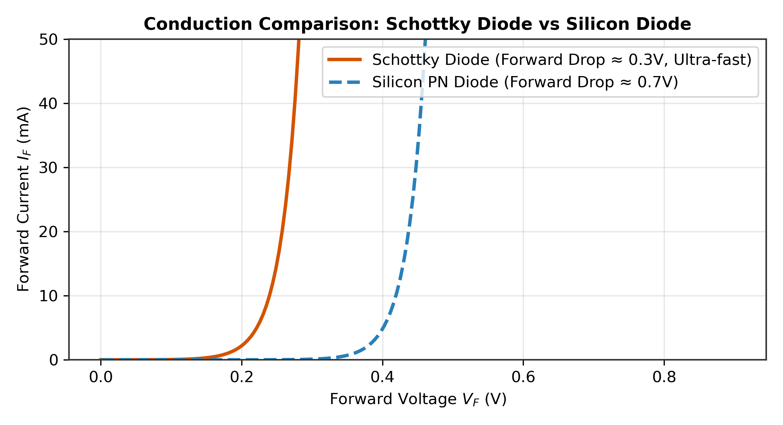
AEN 214: INTRODUCTION TO ELECTRONICS
Schottky Barrier Diodes: Metal-Semiconductor Physics
• Metal-Semiconductor Junction: Replaces the P-type region with a deposited metal barrier (Platinum, Tungsten, or Chromium on N-type silicon).
• Majority Carrier Conduction: Operates purely via thermionic electron emission over the Schottky barrier height q·Phi_B.
• Zero Minority Carrier Storage: Since no holes are injected into N-silicon, reverse recovery time is virtually zero (t_rr < 100 picoseconds).
• Ultra-Low Forward Voltage Drop: V_F ≈ 0.25 V to 0.45 V at typical currents (roughly half that of a standard PN junction diode).
• Trade-Offs: Higher reverse leakage current (microA to mA) and lower maximum reverse breakdown voltage (typically V_RRM <= 100 V).
Sokoine University of Agriculture | School of Engineering & Technology | Department of Agricultural Engineering
Slide 12 of 26

Slide 13
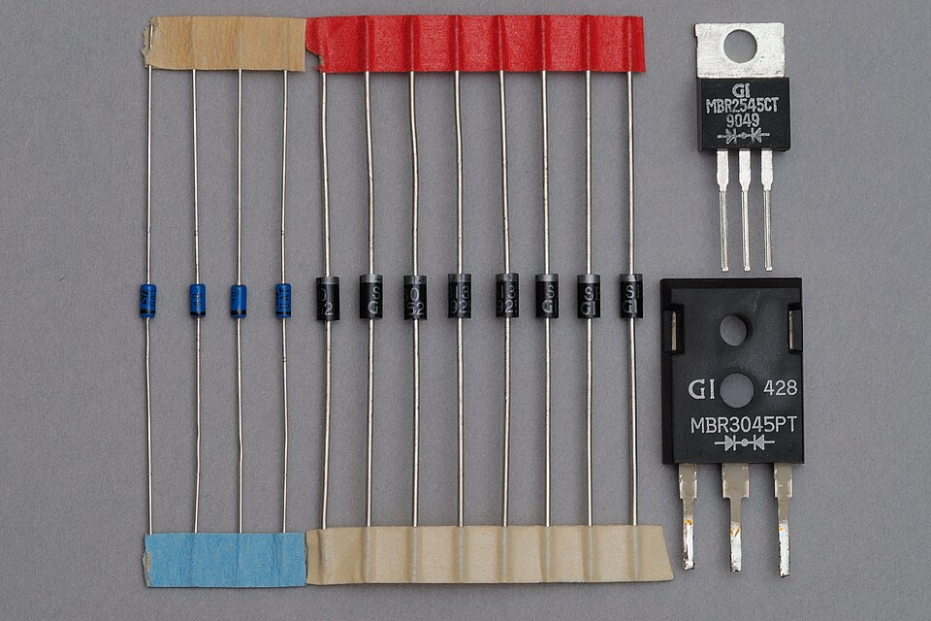
AEN 214: INTRODUCTION TO ELECTRONICS
Solar Panel Hot-Spot Prevention via Bypass Diodes
• The Shading Vulnerability: When dust, bird droppings, or tree shadows obscure one cell in a series string, that cell stops generating current.
• Reverse Bias Choking: Unshaded cells force full string current through the shaded cell, driving it into heavy reverse bias (V_rev > 25V).
• Hot-Spot Destruction: The shaded cell dissipates all string power as localized heat (P = I_string · V_rev > 150W), melting EVA encapsulation and cracking glass.
• Bypass Diode Action: Placing anti-parallel Schottky diodes across groups of 18–24 cells provides an alternate low-resistance bypass path.
• Schottky Thermal Advantage: With 10A string current, a standard silicon diode dissipates P = 10A · 0.9V = 9.0W; a Schottky dissipates only 10A · 0.38V = 3.8W.
Sokoine University of Agriculture | School of Engineering & Technology | Department of Agricultural Engineering
Slide 13 of 26

Slide 14
AEN 214: INTRODUCTION TO ELECTRONICS
Worked Engineering Example 3: Thermal Sizing of Solar Bypass Diodes at Dodoma
PROBLEM SPECIFICATION & AGRICULTURAL CONTEXT:
A 400W solar photovoltaic module installed at a Dodoma borehole pumping station consists of 72 series cells partitioned into 3 sub-strings of 24 cells each, protected by 3 bypass diodes in the junction box. The module short-circuit current is I_sc = 11.2 A. Under cloud edge shading, one sub-string is fully bypassed. Ambient temperature inside the junction box reaches T_amb = 55°C. Compare: (a) Standard 15A silicon rectifier (V_F = 0.85V, theta_JA = 8.5°C/W), versus (b) 15A Schottky diode (V_F = 0.36V, theta_JA = 8.5°C/W). Determine junction temperatures.
STEP-BY-STEP MATHEMATICAL SOLUTION & VERIFICATION:
1. Power Dissipated in Standard Silicon Diode: P_Si = I_sc · V_F(Si) = 11.2 A · 0.85 V = 9.52 W.
2. Junction Temperature Rise for Silicon Diode: Delta T_Si = P_Si · theta_JA = 9.52 W · 8.5°C/W = 80.9°C.
Total Silicon Junction Temp: T_J(Si) = T_amb + Delta T_Si = 55°C + 80.9°C = 135.9°C. ( dangerously close to 150°C silicon limit!).
3. Power Dissipated in Schottky Diode: P_Schottky = I_sc · V_F(Schottky) = 11.2 A · 0.36 V = 4.032 W.
4. Junction Temperature Rise for Schottky Diode: Delta T_Schottky = P_Schottky · theta_JA = 4.032 W · 8.5°C/W = 34.3°C.
Total Schottky Junction Temp: T_J(Schottky) = 55°C + 34.3°C = 89.3°C (comfortable 60°C safety margin!).
5. Engineering Conclusion: Schottky diodes cut junction box heat generation by 58%, preventing junction box melting.
Sokoine University of Agriculture | School of Engineering & Technology | Department of Agricultural Engineering
Slide 14 of 26

Slide 15
AEN 214: INTRODUCTION TO ELECTRONICS
Photodiodes & Solar Photovoltaic Transducers
• Reverse-Biased Operation: Photodiodes operate in the 3rd quadrant (reverse bias) where photocurrent is strictly proportional to light intensity.
• Internal Photoelectric Effect: Incident photons with energy h·f > E_g break valence bonds, creating electron-hole pairs in the depletion layer.
• Electric Field Sweep: Internal junction field instantly sweeps electrons to N and holes to P, generating photocurrent: I_photo = R_lambda · P_opt.
• PIN Photodiode: Wide intrinsic (I) layer sandwiched between P and N widens depletion volume, maximizing optical sensitivity and speed.
• Solar Photovoltaic Cell: Operates in the 4th quadrant (forward bias, delivering power); large-area silicon PN junction optimized for solar energy.
Sokoine University of Agriculture | School of Engineering & Technology | Department of Agricultural Engineering
Slide 15 of 26

Slide 16
AEN 214: INTRODUCTION TO ELECTRONICS
Transient Voltage Suppressors (TVS) for Farm Transients
• Silicon Avalanche Diodes: Engineered specifically for high-energy transient absorption rather than continuous steady-state regulation.
• Response Time: Ultra-fast picosecond response clamping time (< 1 ps), clamping electrostatic discharge (ESD) and lightning surges.
• Peak Pulse Power Ratings: Standard packages absorb 400W, 600W, 1,500W (1.5KE series), or 5,000W for standard 10/1000 microsecond surge pulses.
• Unidirectional vs Bidirectional TVS: Unidirectional used on DC supplies; bidirectional (back-to-back Zeners) used on AC lines and CAN-bus telemetry.
• Tractor CAN-Bus Protection: Bidirectional TVS clamps differential data lines (CAN_H, CAN_L) to prevent transceiver chip latch-up.
Sokoine University of Agriculture | School of Engineering & Technology | Department of Agricultural Engineering
Slide 16 of 26

Slide 17
AEN 214: INTRODUCTION TO ELECTRONICS
Varactor & Tunnel Diodes in Agricultural Communications
• Varactor Diode (Varicap): Silicon diode designed to exploit variable junction capacitance under reverse bias: C_j proportional to (V_R + V_0)^-n.
• Voltage-Controlled Tuning: By altering reverse DC voltage from 1V to 15V, capacitance tunes from 100 pF to 10 pF.
• VCO & Farm IoT Transceivers: Frequency modulation in LoRa/Zigbee farm telemetry radios transmitting soil moisture data across large plantations.
• Tunnel (Esaki) Diode: Extremely degenerate doping (10^20 cm^-3); produces negative differential resistance (dV/dI < 0) at low forward bias.
• Negative Resistance Oscillation: Used in microwave Doppler radar ground-speed sensors mounted underneath tractors to monitor wheel slippage.
Sokoine University of Agriculture | School of Engineering & Technology | Department of Agricultural Engineering
Slide 17 of 26

Slide 18
AEN 214: INTRODUCTION TO ELECTRONICS
Optocouplers: Galvanic Isolation in Farm Automation
• Physical Structure: Infrared LED optically coupled to a silicon phototransistor inside a light-tight DIP package.
• Galvanic Isolation: Provides 2,500V to 5,000V of electrical isolation between sensitive microcontrollers and noisy farm power machinery.
• Ground Loop Elimination: Eliminates ground potential differences between remote pumping stations and central farm control computers.
• Current Transfer Ratio (CTR): Percentage ratio of phototransistor collector current to LED forward current: CTR = (I_C / I_F) x 100%.
• Solid-State Relays (SSRs): High-voltage optocouplers driving anti-parallel TRIACs to silently switch AC irrigation pumps without contact bounce.
Sokoine University of Agriculture | School of Engineering & Technology | Department of Agricultural Engineering
Slide 18 of 26

Slide 19
AEN 214: INTRODUCTION TO ELECTRONICS
Thermal Engineering & Field Packaging for Diodes
• Junction-to-Case Thermal Resistance (theta_JC): Heat flow path from silicon die to metal tab; requires thermal grease (silicone paste).
• Heat Sink Selection: Total thermal resistance theta_total = theta_JC + theta_CS + theta_SA; determines maximum safe continuous current.
• Dust Blanket Derating: In dusty grain elevator environments, derate heatsink thermal dissipation by 35% due to insulating particulate layer.
• Solar Panel Junction Box Ingress: Junction boxes must meet IP67 hermetic ingress standards to block torrential monsoonal rains.
• TVS Surge Coordination: Pair TVS diodes with upstream polymeric PTC reset fuses to guarantee sustained protection against long-duration overvoltages.
Sokoine University of Agriculture | School of Engineering & Technology | Department of Agricultural Engineering
Slide 19 of 26

Slide 20
AEN 214: INTRODUCTION TO ELECTRONICS
Tanzanian Field Case Study 1: Schottky Solar Bypass Retrofit at Dodoma Borehole
FIELD LOCATION & PROBLEM IDENTIFICATION
• Geographic Location: Makutupora Groundwater Basin, Dodoma Region, Tanzania
A 15 kW solar photovoltaic borehole pumping installation powering community drip irrigation suffered melted junction boxes and cracked solar panels. Acacia tree morning shadows across bottom panel rows caused unshaded cells to drive shaded strings into intense reverse breakdown, melting bypass diode solder and starting localized fires.
SUA ENGINEERING SOLUTION & AGRONOMIC IMPACT
SUA agricultural engineers inspected the failed junction boxes and discovered factory-fitted standard silicon diodes that overheated under the 10.8A string current. Engineers retrofitted the entire 48-panel array with 15A, 45V trench Schottky barrier diodes (V1545PW) mounted on anodized aluminum heat spreader clips.
Measurable Performance Metrics:
✔ Reduced junction box operating temperatures from 142°C to a stable 76°C under full shading.
✔ Completely eliminated solar panel hot-spot burnouts across 3 years of operation.
✔ Increased annual solar water delivery by 8.4% through reduced diode conduction losses.
Sokoine University of Agriculture | School of Engineering & Technology | Department of Agricultural Engineering
Slide 20 of 26

Slide 21
AEN 214: INTRODUCTION TO ELECTRONICS
Tanzanian Field Case Study 2: PAR LED Spectrum Optimization for Greenhouse Roses
FIELD LOCATION & PROBLEM IDENTIFICATION
• Geographic Location: Mount Meru Floriculture Estate, Arusha Region, Tanzania
A high-value export greenhouse growing premium roses experienced delayed flowering cycles during overcast rainy seasons. Conventional high-pressure sodium (HPS) lighting consumed excessive electrical power (400W per lamp) and generated intense radiant heat that scorched delicate flower petals.
SUA ENGINEERING SOLUTION & AGRONOMIC IMPACT
SUA horticulture and mechatronics engineers installed tailored multi-spectral LED luminaire arrays combining 660 nm deep red (75%), 450 nm royal blue (15%), and 730 nm far red (10%). The LED fixtures delivered a uniform photosynthetic photon flux density (PPFD) of 220 micro-mol/m²·s directly over the crop canopy with precise dimming control.
Measurable Performance Metrics:
✔ Shortened flower maturation cycle by 9 days, enabling peak Valentine's Day export delivery.
✔ Electrical lighting energy consumption slashed by 54% compared to HPS lamps.
✔ Petal scorching completely eliminated due to low-heat solid-state lighting emission.
Sokoine University of Agriculture | School of Engineering & Technology | Department of Agricultural Engineering
Slide 21 of 26

Slide 22
AEN 214: INTRODUCTION TO ELECTRONICS
Laboratory Bench Protocol: Zener Shunt Regulation & LED Spectrum Characterization
PRACTICAL LAB LEARNING OUTCOMES & BENCH REQUIREMENTS:
• Measure Zener diode breakdown curve and evaluate knee current I_ZK on curve tracer.
• Build a 5.1V Zener shunt regulator and measure line regulation and load regulation.
• Determine the forward voltage drop V_F of Red, Green, Blue, and White LEDs.
• Characterize a Schottky diode against a silicon diode to observe forward drop disparity.
STEP-BY-STEP PROTOTYPING & DIAGNOSTIC PROCEDURE:
Step 1: Wire 5.1V Zener diode (1N4733A) in series with 470 Ohm resistor to variable DC bench supply.
Step 2: Sweep DC supply from 0V to 15V; record V_Z and I_Z; identify Zener knee point on graph.
Step 3: Connect variable decade resistance box as load R_L; vary I_L from 0 to 30 mA; log V_out to calculate load regulation %.
Step 4: Test Red (GaAsP), Green (GaP), and Blue (InGaN) LEDs at I_F = 15 mA; verify relationship between photon energy and V_F.
Step 5: Measure forward voltage of 1N5819 Schottky vs 1N4007 silicon diode at 500 mA on DSO; confirm 0.35V vs 0.85V drop.
Sokoine University of Agriculture | School of Engineering & Technology | Department of Agricultural Engineering
Slide 22 of 26

Slide 23
AEN 214: INTRODUCTION TO ELECTRONICS
Diagnostic Troubleshooting of Special Purpose Diodes
• Zener Regulator Dropout: If input voltage V_in dips too low, Zener drops below knee current I_ZK and output loses regulation.
• Zener Thermal Burnout: If load is disconnected without sizing R_S for full load removal, all current shunts through Zener, exceeding P_Z(max).
• LED Reverse Voltage Vulnerability: Most LEDs have low reverse breakdown ratings (V_R < 5V); easily destroyed if connected backwards to 12V rails.
• Schottky Thermal Leakage Runaway: In high-temperature engine compartments, Schottky reverse leakage surges exponentially, causing runaway.
• TVS Degradation: Repeated intense lightning surges cause TVS diodes to degrade and eventually fail as a permanent low-resistance short circuit.
Sokoine University of Agriculture | School of Engineering & Technology | Department of Agricultural Engineering
Slide 23 of 26

Slide 24
AEN 214: INTRODUCTION TO ELECTRONICS
Lecture 4 Self-Assessment & Upcoming Topics
SELF-ASSESSMENT & PROBLEM-SOLVING EXERCISES:
Q: Differentiate between Zener breakdown and Avalanche breakdown in terms of physical mechanism, voltage thresholds, and temperature coefficients.
Q: Why is a ballast resistor R_S mandatory in a Zener shunt regulator circuit, and what happens if R_S is made too large or too small?
Q: Explain why compound semiconductors (e.g. GaAs, InGaN) emit light efficiently upon forward bias, while elemental silicon does not.
Q: Why are Schottky barrier diodes preferred over standard PN junction diodes as bypass diodes in solar photovoltaic panels?
Q: A 6.2V Zener diode has dynamic resistance r_z = 5.0 Ohm. If Zener current increases by 15 mA, calculate the change in regulated voltage.
NEXT LECTURE PREVIEW & REQUIRED PREPARATION:
Lecture 5 will explore the Bipolar Junction Transistor (BJT): Physics, biasing rules, CE/CB/CC configurations, DC load lines, and switches.
Sokoine University of Agriculture | School of Engineering & Technology | Department of Agricultural Engineering
Slide 24 of 26

Slide 25
AEN 214: INTRODUCTION TO ELECTRONICS
Lecture 4 Synthesis: Key Takeaways & Formula Sheet
CORE CONCEPTUAL TAKEAWAYS
✔ Zener diodes provide highly stable voltage references when operated in reverse breakdown (V_Z).
✔ Zener shunt regulator design requires sizing R_S between R_S(min) and R_S(max) to balance dropout and thermal limits.
✔ LEDs convert electrical energy directly into light via radiative recombination in direct-bandgap materials.
✔ Tailored LED spectra (PAR: 450 nm blue + 660 nm red) dramatically improve greenhouse crop photosynthesis.
✔ Schottky barrier diodes offer ultra-low forward drops (0.3V) and zero t_rr, making them ideal for solar bypass protection.
CRITICAL ENGINEERING FORMULAS
★ Zener Power Limit: P_Z(max) = V_Z · I_ZM
★ Ballast Resistor Max: R_S(max) = (V_in(min) - V_Z) / (I_L(max) + I_ZK)
★ Ballast Resistor Min: R_S(min) = (V_in(max) - V_Z) / (I_L(min) + I_ZM)
★ LED Photon Wavelength: lambda = 1240 / E_g(eV) (nm)
★ Schottky Forward Drop: V_F ≈ 0.25 V to 0.45 V
★ Photocurrent: I_photo = R_lambda · P_optical
★ Junction Temperature: T_J = T_amb + P_diss · theta_JA
Sokoine University of Agriculture | School of Engineering & Technology | Department of Agricultural Engineering
Slide 25 of 26

Slide 26
AEN 214: INTRODUCTION TO ELECTRONICS
Prescribed References & Practical Laboratory Preparation
• Boylestad, R. L., & Nashelsky, L. (2018). Electronic Devices and Circuit Theory (11th ed.). Pearson Education.
• Sedra, A. S., & Smith, K. C. (2020). Microelectronic Circuits (8th ed.). Oxford University Press.
• Floyd, T. L. (2017). Electronic Devices: Conventional Current Version (10th ed.). Pearson.
• Laboratory Preparation: Review LED current limiting resistor calculations before attending Lab Session 4.
• Field Assignment: Complete Assignment 2, Questions 1 to 4 on special purpose diodes and submit via SUA LMS.
Sokoine University of Agriculture | School of Engineering & Technology | Department of Agricultural Engineering
Slide 26 of 26

